Slide 2
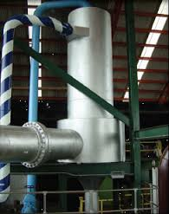
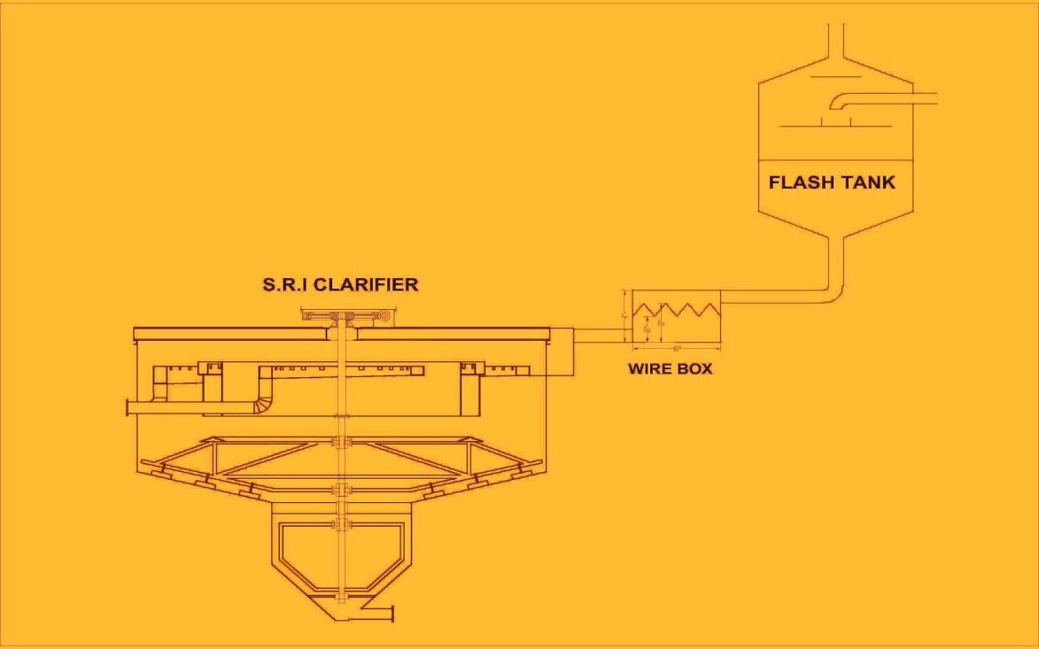
Haseeb Waqas Sugar Mills Ltd EFFICIENCY OF JUICE CLARIFIER
PRESENTED BY: ATIF SATTAR
(GENERAL MANAGER)

Slide 3
ABSTRACT
Over the year clarification system in sugar industry has been improved. This presentation is also related the issue of juice clarification in SRI clarifier (due to its low retention time). Temperature fluctuation create major problem in juice clarification, The HWSML has faced the same problem (mostly at cane crushing fluctuation). The problem has been rectified by maintaining constant Temp. of juice and Reduction in juice velocity by installation of DC Heater along with Weir Box and get a great benefit, as now the cost of production is at peak and price of sugar is low.

Slide 4
INTRODUCTION
The clear juice play a vital role during processing and key to produce good quality of sugar with minimum loss.
There are number of factors depending upon the clarifier efficiency and juice clarity.
Temperature of juice
Retention time
Juice velocity
PH
P₂ O₅
Flow Rate
Mud Volume

Slide 5
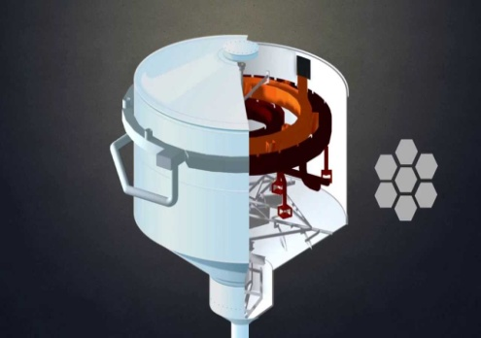
CONTD…
Gases Removal
Brix of juice
Flocculent dose
Bagacillo quantity
Complete chemical reaction of CaO
But the major factor is constant and consistent temperature of SRI clarifier around the clock (due to its short retention time).
Due to low temperature the bagacillo and mud carryovers create a major problem during sugar boiling and processing.

Slide 6
CONTD…
Cleaning problems at Evaporator and reduction in H.S
Chocking of Centrifugal screens and Reduction in screening area.
Exhaustibility of F.M.
Product color
Sugar loss
For removal of Bagacillo and Mud carryovers various good steps has been taken in sugar industry. Like rotary screen and retention time etc.
In Season 2014 – 15 HWSM Ltd has been taken step to over come the problems which gave a remarkable success.

Slide 7
CONTD…
(A). Installation of Direct Contact heater at secondary juice heating (107⁰c) at last stage by 1st vapour ( 112⁰c).
(B). Installation of weir box at juice entry in Clarifier.
(A). Direct contact Heater not only economical in shape of cost and cleaning but also help to reduce energy required and assets to complete the chemical reaction between CaO contents and P₂O₅ contents of juice
The energy balance of DC Heater is given below.
Cane crushing = 8000 TCD @ 333 Ton / hour.
Exhaust Steam (125⁰C) required = 8.8 Ton / hour to raise temperature(from 92⁰C to 107⁰ C)
Exhaust Steam Heating value 522 Kcal/kg.
1st Vapour (112⁰C) required = 8.65 Ton / hour
Indirect Heating to raise temperature(from 92⁰C to 107⁰ C)
1st vap. Heating value 531 Kcal/kg.

Slide 8
CONTD…
1st Vapour (112⁰C) required = 7.14 Ton / hour
Direct Heating to raise temperature(from 92⁰C to 107⁰ C) 1st vap. Heating value 643 Kcal/kg.
Energy saving by direct heating = 1.51 Ton / hour.
Extra energy required due to addition of water (N/5) = 1.43 Ton / hour.
There is no big difference between heat loss and gain, (because some heat loss in leakages due to indirect heating) but gain a lot of following advantages.
The exhaust steam saving will be used for Pre juice heating of final stage to rise juice temperature 115⁰C - 120⁰C minimum for spontaneously evaporation and rise in Temp. of vapours specially in Robert evaporators.

Slide 9
CONTD…
Constant and consistent juice Temp. (107⁰C ) maintained by 1st vapour.
Due to extra addition of water juice brix decreased.
Clarification effect increase by 2 to 3 ⁰
No cleaning required.
Reduction in juice velocity.
Cost effective.
Shining juice without bagacillo and
Mud carryovers.
Reduction in CaO contents of juice
From 900 to 600 ppm.

Slide 10
DC Heater also assist to complete chemical reaction between lime contents and juice impurities which not only reduce CaO contents of juice, but also produce heavy Mud floc necessary for rapid settling of mud in Clarifier ( resulting rise in purity of juice and better clarification).
Complete reaction mechanism can be achieved by increasing entropy of molecules through time and again hitting with metal parts of Heater i.e deflection plates and contact trays. ( as mention in next slide).

Slide 11
Design of DC Heater (HWSML)

Slide 12
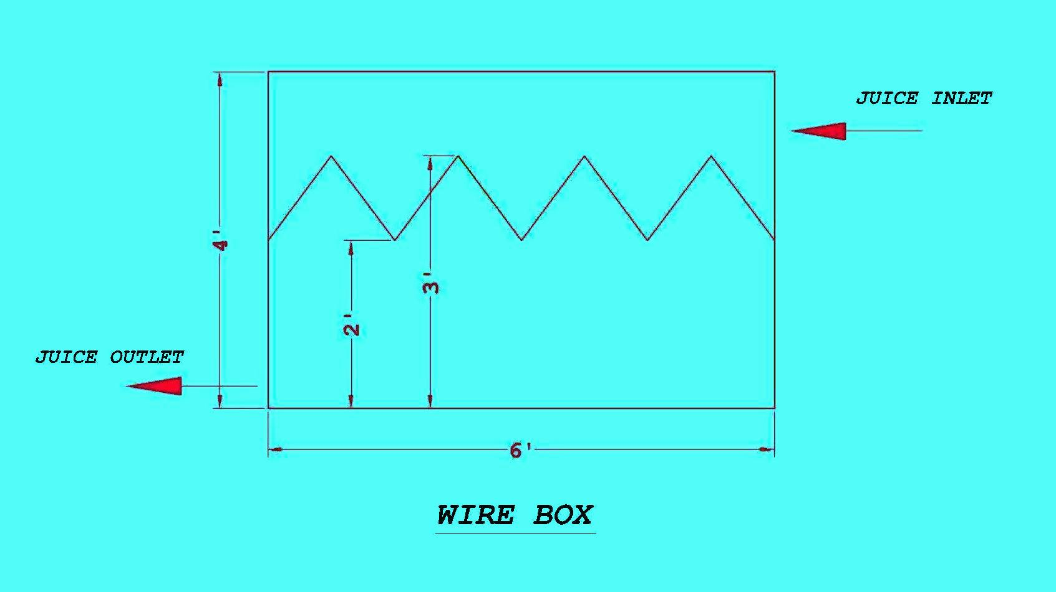
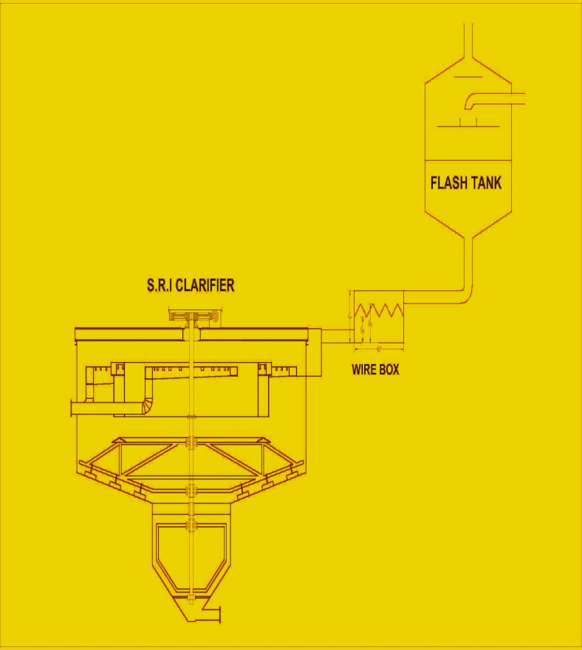
Installation of WEIR box
For smooth laminar juice flow before entrance of juice in Clarifier.
Design of Weir Box
Dimension = 4x4x6 Feet

Slide 13
Conclusion
If there are not thousand of dollars available for big modification does not means that a small effort cannot be unique and give thoroughly satisfying results and is not the final seal on the project.
Installation of only one DC Heater at secondary juice heating last stage has a remarkable results.

Slide 14
ACKNOWLEDGMENT
Author is highly grateful to higher management for presentation of this paper in P.S.S.T convention. Special thanks to the whole HWSML team.

Slide 15
THANKS
Any Questions

